Slide 1
Wind and Solar Energy Modeling and Analysis
Technical Presentation
By
Mohamed Abuella
The University of North Carolina at Charlotte
August 6th, 2019

Slide 2
Who am I ?
Mohamed Abuella
An electrical engineer by training, traditionally is interested in Mathematical and Computational Analysis, Modeling and Optimization, and who is recently get passionate in Artificial Intelligence and Data-driven Analytics for Energy and Smart Grid applications.
Hobbies and Interests
Making Mediterranean Food and Drink, but also try my own out-of-box recipes;
Stretching, Walking, Running, or Swimming, Diving.. and hopefully Climbing; Wondering around and Discovering New Places, ..kind of adventure;
Watching, Reading and Sharing Stuff on Internet, useful & dumb things;
And more often just.. Chilling and Enjoy Doing Nothing!

Slide 3
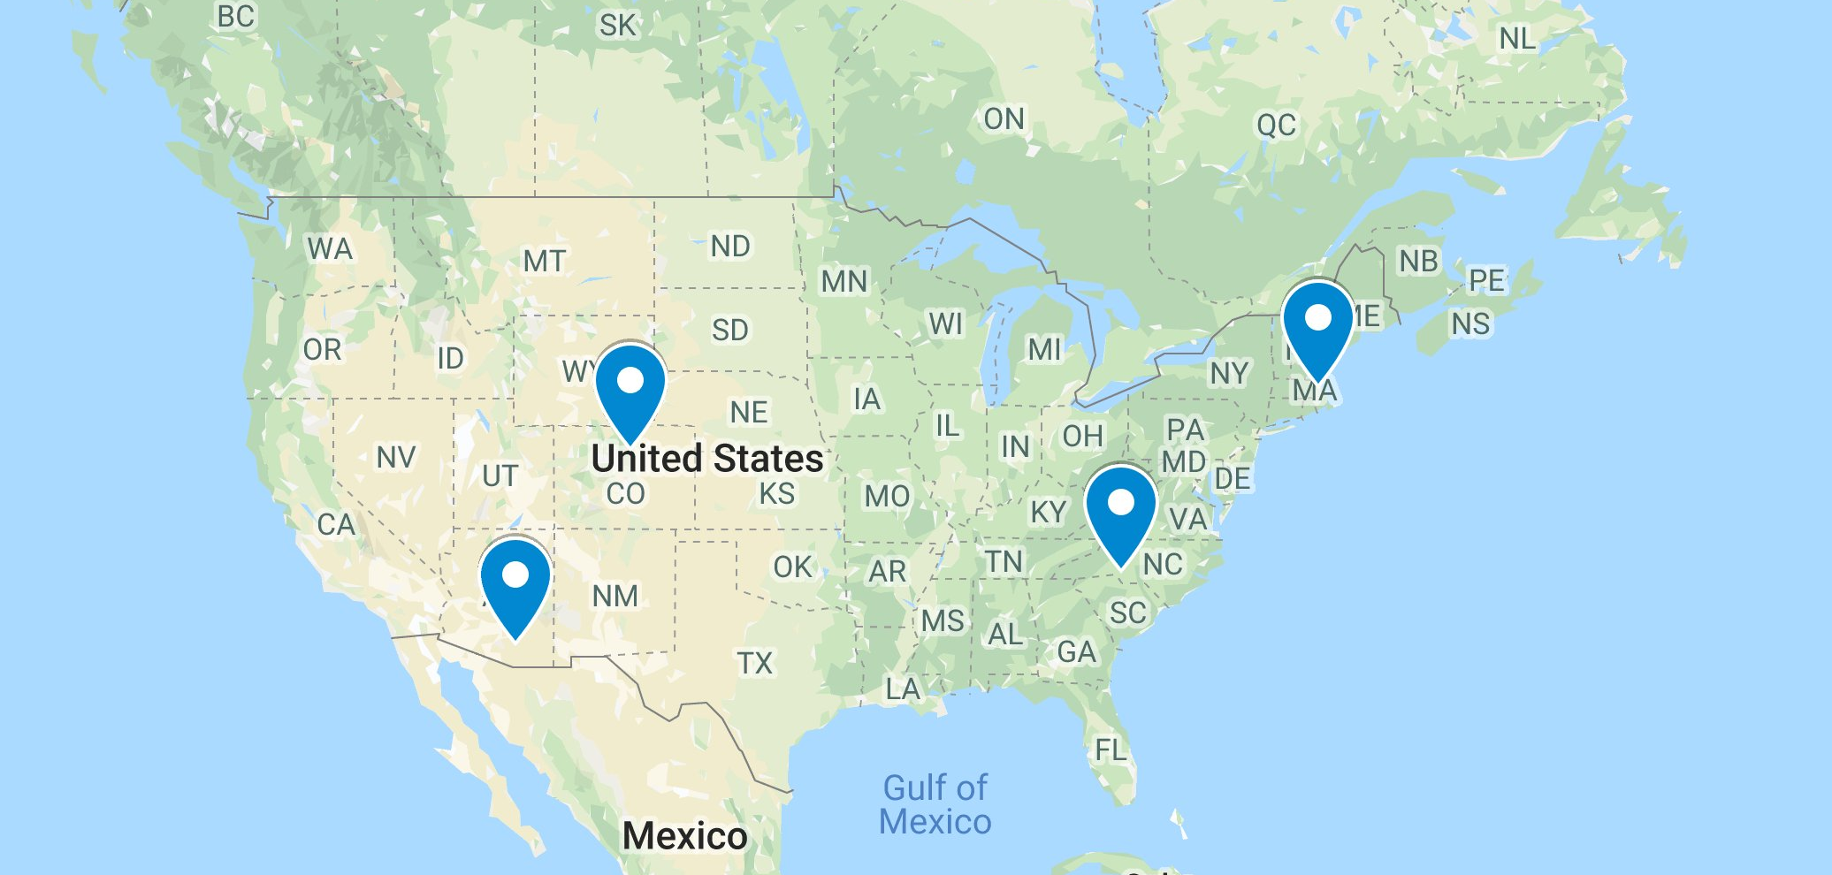
Wind and Solar Energy Modeling
Modeling for Different Locations in the U.S.
Four U.S. Locations for Comparison of Renewable Energy Modeling and Analysis
Charlotte NC, Boston MA, Boulder CO, Tucson AZ.
Data are retrieved from NREL’s Developer Network: https://developer.nrel.gov/

Slide 4
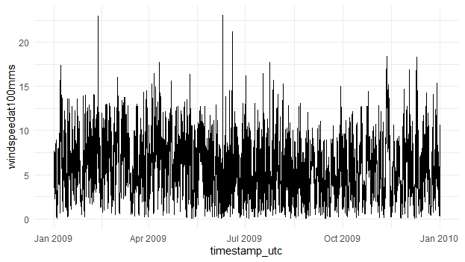
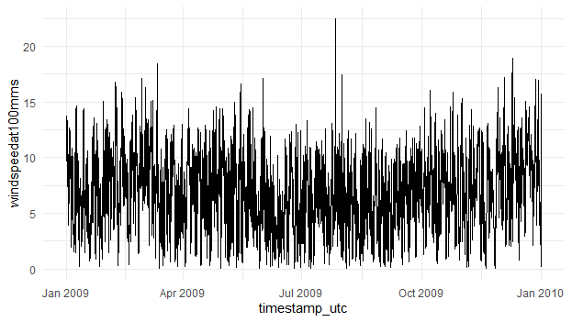
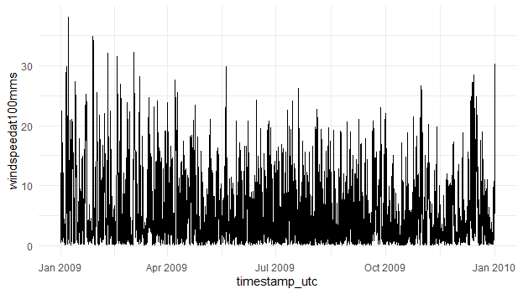
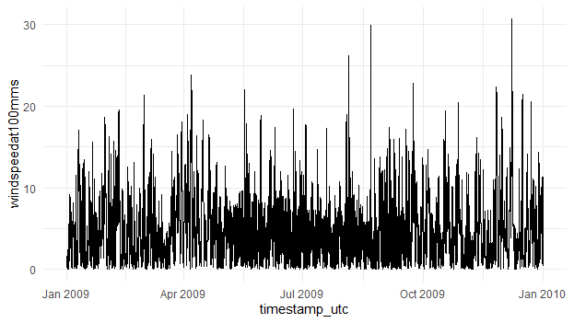

Wind Energy Modeling
Charlotte, NC
Time series of wind speed at height 100m (m/s)
Boston, MA
$$Pw=\frac{1}{2}ρAv^{3}$$
Boulder, CO
Tucson, AZ

Slide 5
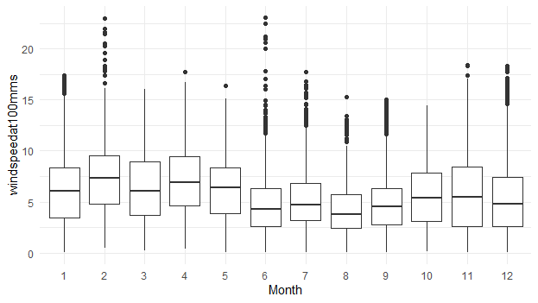
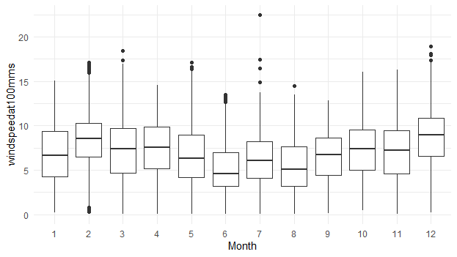
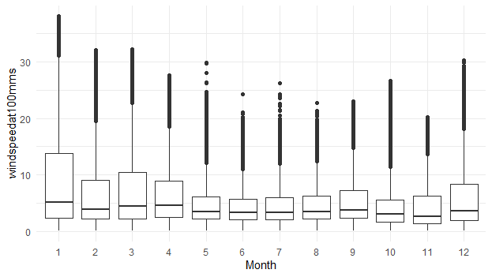
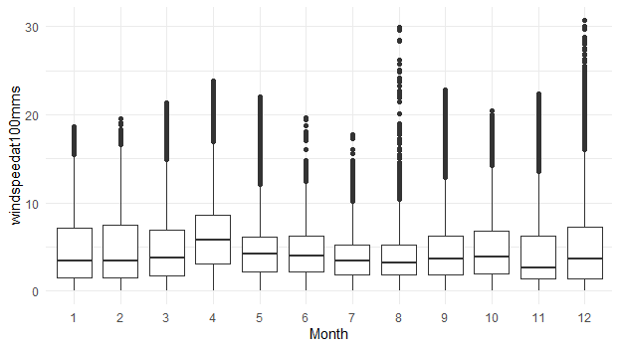
Wind Energy Modeling
Charlotte, NC
Boxplots of monthly distribution of wind speed
Boston, MA
Boulder, CO
Tucson, AZ

Slide 6
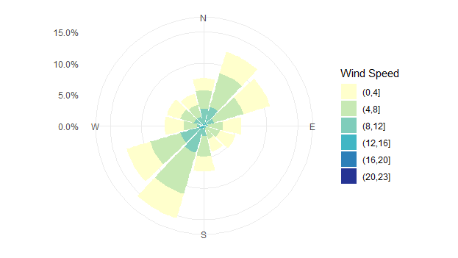
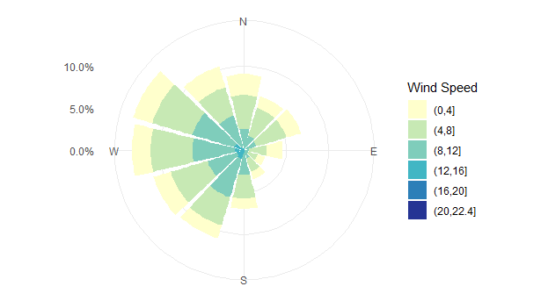
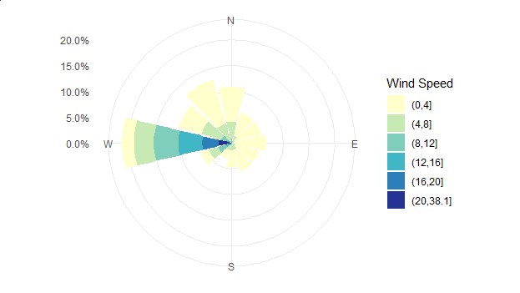
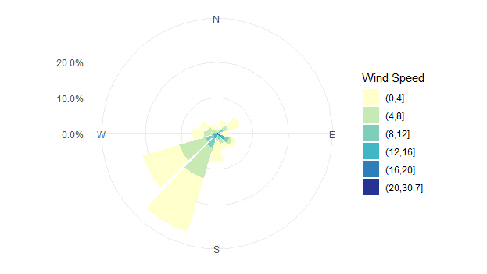
Wind Energy Modeling
Charlotte, NC
Wind Roses of Wind Speed
Boston, MA
Distribution of wind direction and speed
Boulder, CO
Tucson, AZ

Slide 7
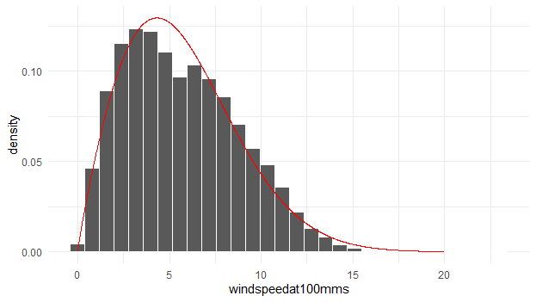
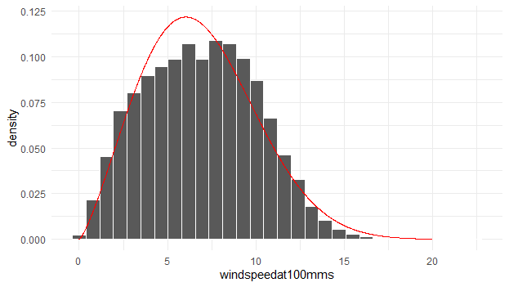
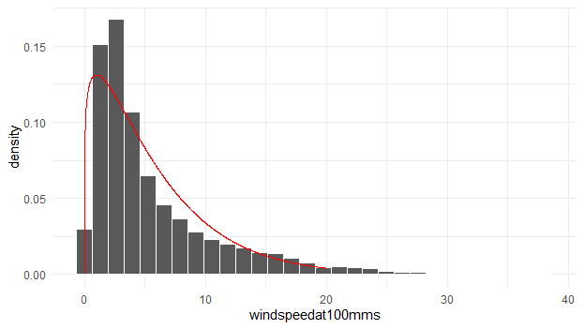
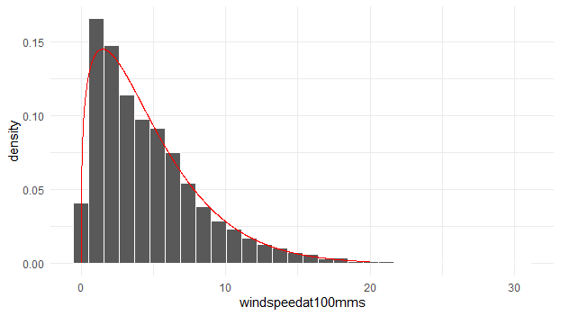
Wind Energy Modeling
Charlotte, NC
Probability density distribution of wind speed
Boston, MA
Boulder, CO
Tucson, AZ

Slide 8
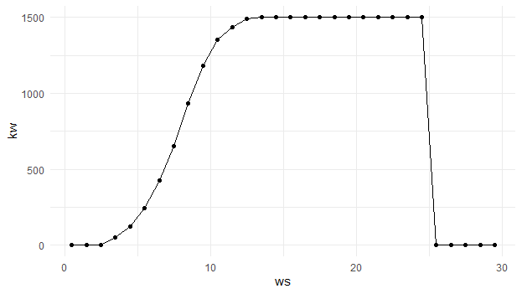

Wind Energy Modeling
Charlotte, NC
Wind turbine GE 1.5SLE 77m is utilized for modeling
Boston, MA
The wind power curve for GE 1.5SLE 77m
to covert the wind speed to wind power
$$Pw=\frac{1}{2}ρAv^{3}$$
Boulder, CO
Tucson, AZ
http://www.wind-power-program.com/Downloads/Databasepowercurves(May2017).zip

Slide 9
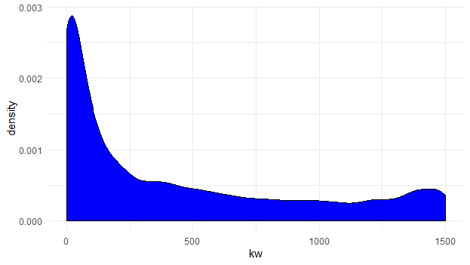
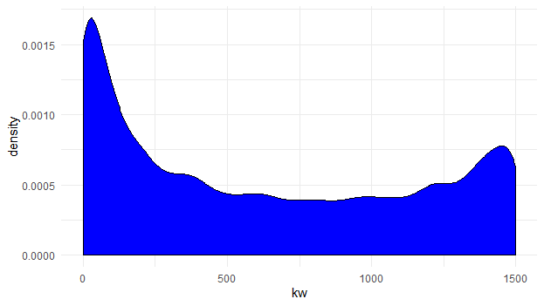
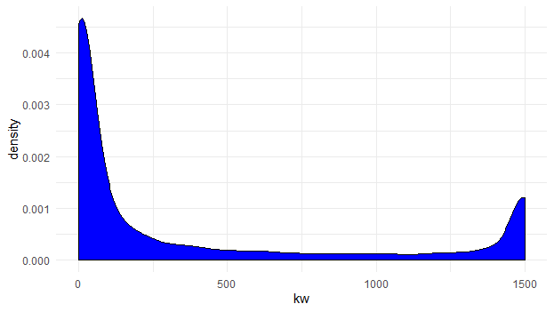
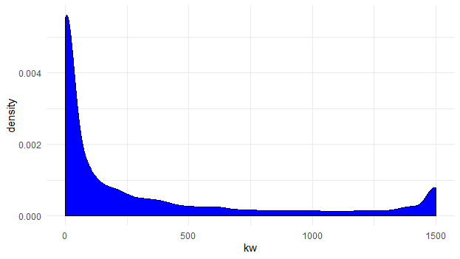

Wind Energy Modeling
Charlotte, NC
Probability density distribution of wind power
Boston, MA
Considering other parameters such as air pressure, temperature and density at the given height=100m
$$Pw=\frac{1}{2}ρAv^{3}$$
Boulder, CO
Tucson, AZ

Slide 10

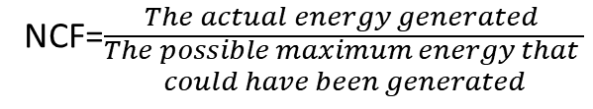
Wind Energy Modeling
Charlotte, NC
Wind Energy Modeling
in 2009
Boston, MA
Month | MWh | NCF
1 | 387.574 | 34.70%
2 | 455.725 | 45.20%
3 | 410.236 | 36.80%
4 | 456.256 | 42.20%
5 | 381.352 | 34.20%
6 | 193.475 | 17.90%
7 | 230.690 | 20.70%
8 | 141.379 | 12.70%
9 | 197.738 | 18.30%
10 | 310.630 | 27.80%
11 | 355.663 | 32.90%
12 | 298.279 | 26.70%
Month0 | MWh | NCF
1 | 467.945 | 41.90%
2 | 584.361 | 58.00%
3 | 510.499 | 45.70%
4 | 512.191 | 47.40%
5 | 420.662 | 37.70%
6 | 239.808 | 22.20%
7 | 354.663 | 31.80%
8 | 285.923 | 25.60%
9 | 396.328 | 36.70%
10 | 504.488 | 45.20%
11 | 471.683 | 43.70%
12 | 691.553 | 62.00%
Calculating the net capacity factor (NCF)
for each month, then over the entire year
NCF=$\frac{The actual energy generated }{\begin{aligned}The possible maximum energy that \\ could have been generated\end{aligned}}$
Boulder, CO
Tucson, AZ
Month | MWh | NCF
1 | 413.396 | 37.00%
2 | 288.217 | 28.60%
3 | 382.094 | 34.20%
4 | 339.568 | 31.40%
5 | 222.077 | 19.90%
6 | 187.928 | 17.40%
7 | 216.100 | 19.40%
8 | 215.737 | 19.30%
9 | 268.648 | 24.90%
10 | 206.966 | 18.50%
11 | 224.898 | 20.80%
12 | 312.770 | 28.00%
NCF=$\frac{The actual energy (MWh) }{The capacity ∗time (MWh)}$
Month0 | MWh | NCF
1 | 262.764 | 23.50%
2 | 247.664 | 24.60%
3 | 259.804 | 23.30%
4 | 378.228 | 35.00%
5 | 184.679 | 16.50%
6 | 188.630 | 17.50%
7 | 111.523 | 10.00%
8 | 143.448 | 12.90%
9 | 223.078 | 20.70%
10 | 258.261 | 23.10%
11 | 236.885 | 21.90%
12 | 274.958 | 24.60%

Slide 11
Wind Energy Modeling
Wind Energy Modeling
in 2009 and 2010
2009 | MWh | NCF
Charlotte | 3818.9 | 29.1%
Boulder | 3278.4 | 24.9%
Boston | 5440.1 | 41.4%
Tucson | 2769.9 | 21.1%
2010 | MWh | NCF
Charlotte | 3544.6 | 27.0%
Boulder | 2676.9 | 20.4%
Boston | 6107.7 | 46.5%
Tucson | 2969.9 | 22.6%

Slide 12
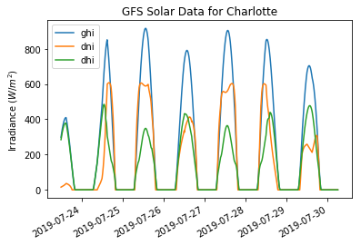
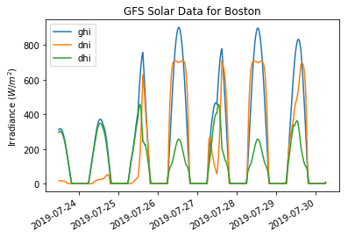
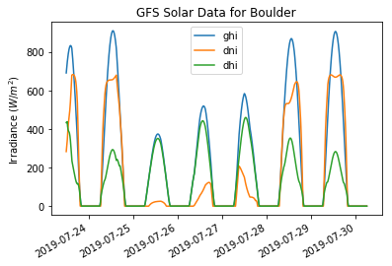
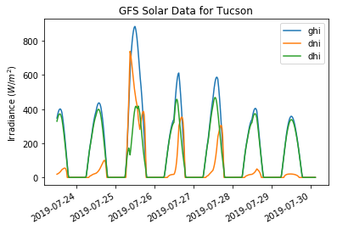
Solar Energy Modeling
Time series of components of solar irradiance, GHI, DNI, DHI (W/m²)
https://pvlib-python.readthedocs.io/en/latest/forecasts.htm

Slide 13
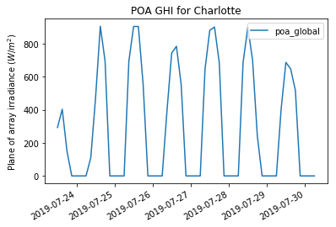
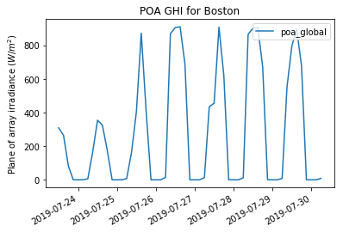
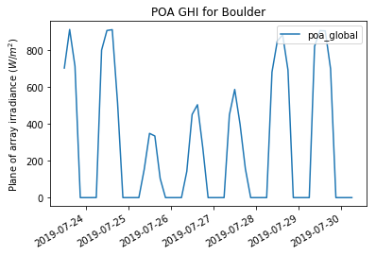
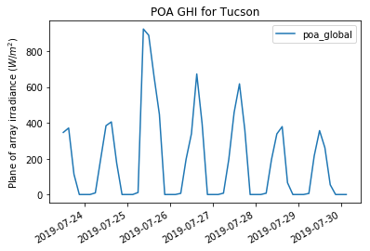
Solar Energy Modeling
Global Horizontal Irradiance (GHI) at the plane of array (POA)
https://pvlib-python.readthedocs.io/en/latest/forecasts.htm

Slide 14
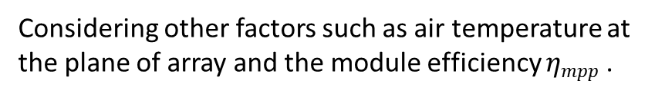
Solar Energy Modeling
Convert GHI at the POA to Solar PV Power
Considering other factors such as air temperature at the plane of array and the module efficiency $ηmpp$ .
$$Psol≅ηmpp\left(GHIPOA , Tm\right)GHIPOA∗A$$
Pvlib Toolbox from Sandia and NREL’s SAM package and Weather Data from GFS Global Model
# get the module and inverter specifications from SAM
sandia_modules = pvlib.pvsystem.retrieve_sam('SandiaMod')
module = sandia_modules['Canadian_Solar_CS5P_220M___2009_’]
Description: 220W Monocrystalline Module http://www.solarhub.com/solarhub_products/106-CS5P-220M-Canadian-Solar
sapm_inverters = pvlib.pvsystem.retrieve_sam('cecinverter’)
inverter = sapm_inverters['ABB__MICRO_0_25_I_OUTD_US_208_208V__CEC_2014_']
system = {'module': module, 'inverter': inverter, ....: 'surface_azimuth': 180}
https://pvlib-python.readthedocs.io/en/latest/introexamples.html

Slide 15
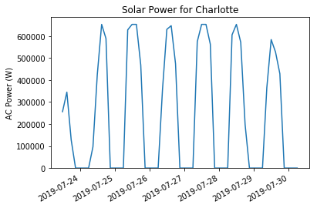
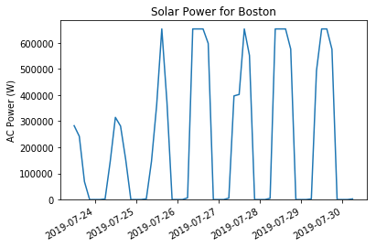
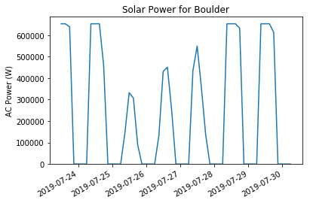
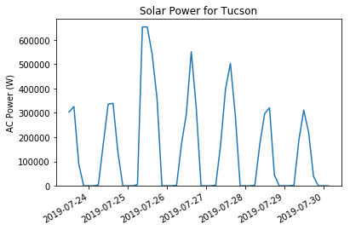
Solar Energy Modeling
Time series of Solar Power (W)
https://pvlib-python.readthedocs.io/en/latest/forecasts.htm

Slide 16
Solar Energy Modeling
For 2009 and 2010, as in the wind energy modeling
2009 | Wh | NCF |  | 2010 | Wh | NCF
Charlotte | 446028 | 23.14% |  | Charlotte | 446035 | 23.14%
Boulder | 491571 | 25.51% |  | Boulder | 491582 | 25.51%
Boston | 451885 | 23.45% |  | Boston | 451899 | 23.45%
Tucson | 467719 | 24.27% |  | Tucson | 467726 | 24.27%

Slide 17
Wind and Solar Energy Modeling
Comparison of NCF for Resources of Wind & Solar Energy
2009 | NCF
 | Wind Energy | Solar Energy
Charlotte | 29.10% | 23.14%
Boulder | 24.90% | 25.51%
Boston | 41.40% | 23.45%
Tucson | 21.10% | 24.27%
2010 | NCF
 | Wind Energy | Solar Energy
Charlotte | 27.00% | 23.14%
Boulder | 20.40% | 25.51%
Boston | 46.50% | 23.45%
Tucson | 22.60% | 24.27%

